Slide 1
Utilization Law & Little’s Law
Software Performance Engineering

Slide 2
Our analysis thus far
We define metrics for each system to measure performance
We use the exponential distribution
To analyze inter-arrival times in a Markovian stochastic system
For a single random variable, e.g. “customers arriving”
…but real systems have multiple random variables interacting!
Servers behave randomly
Customers behave randomly

Slide 3
Arrival Rate & Service Rate
Arrival rate: $\text{λ}$
The rate at which jobs (“customers”) are entering the system
Can be constant, or a parameter to exponential distribution
e.g. “We get 60 customers per hour”
Mean inter-arrival time: 1/ $\text{λ}$
e.g. “We get a new customer every minute”
Service rate: µ
The rate at which our server handles jobs
Can be constant, or a parameter to exponential distribution
e.g. “We can serve 120 customers per hour”
Mean service time: 1/ µ or S
e.g. “We take 2 minutes for every customer”

Slide 4
Traffic Intensity & Utilization
Traffic intensity $ρ$
$ρ=λ/μ=λS$
% measure of load on the overall system
e.g. “Traffic intensity of 50%”
If $ρ≥1$, the system cannot keep up with demand
(a lot of our math breaks down in this situation)
Utilization U
The proportion of time the server is busy
Maxes out at 100%, or saturated
If jobs are never lost, $U=ρ$
If jobs can be lost, $U≤ρ$

Slide 5
Throughput & Queue Length
Throughput: X
The rate at which the entire system processes jobs
(Becomes more complex in multi-service systems)
If jobs can be lost, $\text{X} \text{≤} \text{λ}$
Queue Length: n
The number of jobs present in the system
The number of jobs present at a given server

Slide 6
Response Time & Waiting Time
Response time: $\overline{R}$
The total period of time from a job’s arrival to its final processing
Waiting time
The time that a job must wait in the queue until it is served

Slide 7
Queuing Discipline
FCFS: First Come First Serve
LCFS: Last Come First Serve
e.g. a stack
LCFSPR: Last Come First Served Preemptive Resume
The most recently arriving job preempts the job
That job is served to completion, unless preempted itself
Time Slicing or Round Robin
Each job is given a fixed period of time before it is interrupted and switches to another job in the queue

Slide 8
Utilization Law
These laws are helpful for:
Determining if your measurements are sane
Examining how each your metrics relate to each other
Utilization Law$: U=XS$ = $X/μ$
Utilization is the product of throughput and mean service time
This is true regardless of your queuing discipline
e.g. Coffee Shop S = 2 m/c, “e.g. “We take 2 minutes for every customer” X = 1/4 c/m, “We get 1 customers every 4 minutes” U = 50%

Slide 9
More Utilization Law eg’s
e.g. Processors
Mean service time for a job is 10ms
What is the maximum expected throughput if we want our maximum utilization at 80%?
X = U/S = 0.8/(10 ms/j)= .08 j/ms = 8 jobs/sec

Slide 10
Little’s Law
Mean Queue length $\overline{n}$ is the product of Throughput X and Mean Response Time R
$\overline{n}=X\overline{R}$
e.g. Rollercoaster
On average it takes 15 minutes from getting to the back of the line to riding to exit.
The rollercoaster handles 20 riders/hour (1 rider/3 minutes)
Thus, the mean queue length is: $\overline{n}=X\overline{R}=\frac{15}{3}=5$ riders
e.g. Rollercoaster – should we ride?
The rollercoaster handles 20 riders/hour (1 rider/3 minutes)
Queue length is currently 30
Current line is 30 people. (Assume that is average)
How long will we wait?
$\overline{R}=\frac{n}{X}=\frac{30}{0.333}=90$ minutes

Slide 11
Applied to Single Server Systems
M/M/1 queues
Customer arrival rate is Markovian
Service Rate is Markovian
1 Server
No maximum capacity, infinite customers
$X=λ$ if $ρ≤1$
With a single server, throughput of the entire system is basically just customer arrival rate
$\overline{R}=\frac{\overline{n}}{λ}$
Application of Little’s law with the above assumption

Slide 12
Queue Length of M/M/1
$\overline{n}=\frac{ρ}{1−ρ}$ eq 3.8 from the book, we’ll skip the derivation
e.g. Web app
Customers arrive 1 per second, $λ$=1 c/s
Webapp processes them at 8 per second, $μ=8$ c/s
Traffic intensity: $ρ=\frac{1}{8}=12.5\%$
Mean queue length: $\overline{n}=\frac{0.125}{0.875}=0.142$
e.g. Busy Web app
Customers arrive 6 per second, $λ$=6 c/s
Webapp processes them at 8 per second, $μ=8$ c/s
Traffic intensity: $ρ=\frac{6}{8}=75\%$
Mean queue length: $\overline{n}=\frac{0.75}{0.25}=3$
So our $λ$ increased by 6x, but our $\overline{n}$ increased by 21x!!

Slide 13
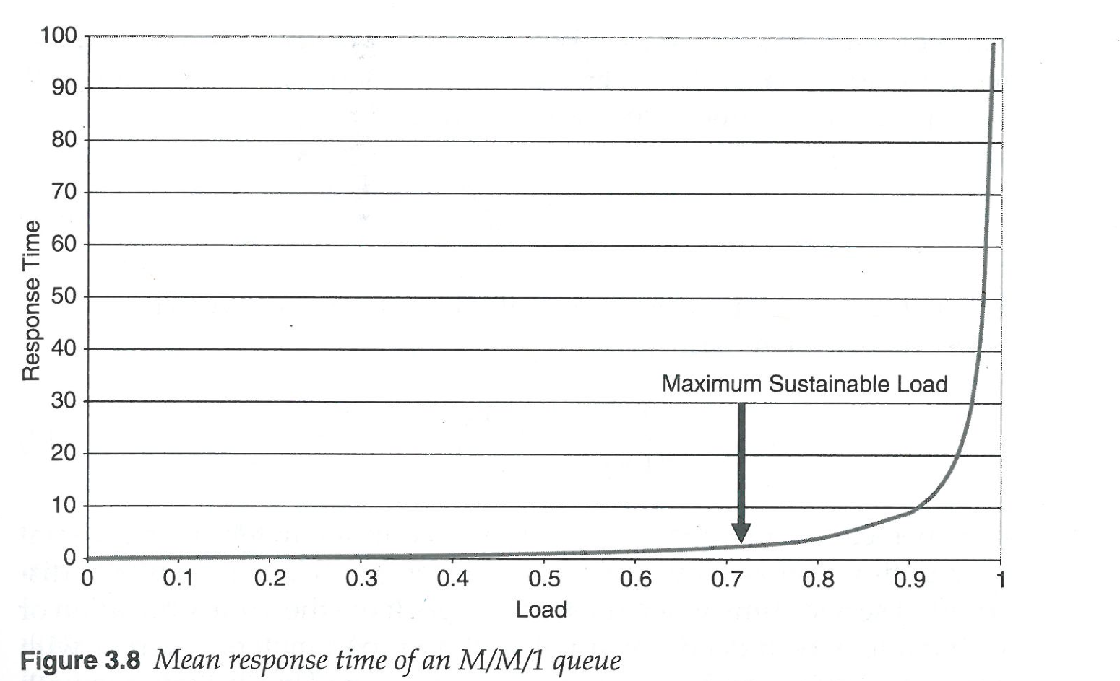
For this chart, assume that $λ$=1 so that $λ=\overline{R}$
Load is $ρ$, or U if jobs are never lost

